Slide 1


NRGoSF
Swiss energy challenge
Benefiting Climate x2
Ana Boskovic Svilen Stefanov Dimitar Dimitrov Luca Autunno
Simone Eberhart Marko Mihajlovic Maurice Cotting

Slide 2




Idea
1) more sustainability, reduce CO₂
2) spend saved money on projects
Challenge
Problem: Take their saved money and spend it: punishement!
Game: - Collecting cute items (Elements) → want to have more
- complete sustainable quests → be sustainable
- include the parents → encourage parents to be sustainable
How get them to change and spend money?
→ Lets let the children change their parents!
Ana Boskovic Svilen Stefanov Dimitar Dimitrov Luca Autunno
Simone Eberhart Marko Mihajlovic Maurice Cotting

Slide 3


Aspects of the game
Blockchain:
Each Element is unique and gets better in higher levels
Money is safely reinvest in sustainable projects
Competition/Trading → create a hype
Quests get children to be sustainable
Parents have to be sustainable:
Buy Elements→ donation
Integrate IoT devices, walk the child to school, etc.
Collect and visualize data (baseline quiz, integrate IoT devices)
Ana Boskovic Svilen Stefanov Dimitar Dimitrov Luca Autunno
Simone Eberhart Marko Mihajlovic Maurice Cotting

Slide 4
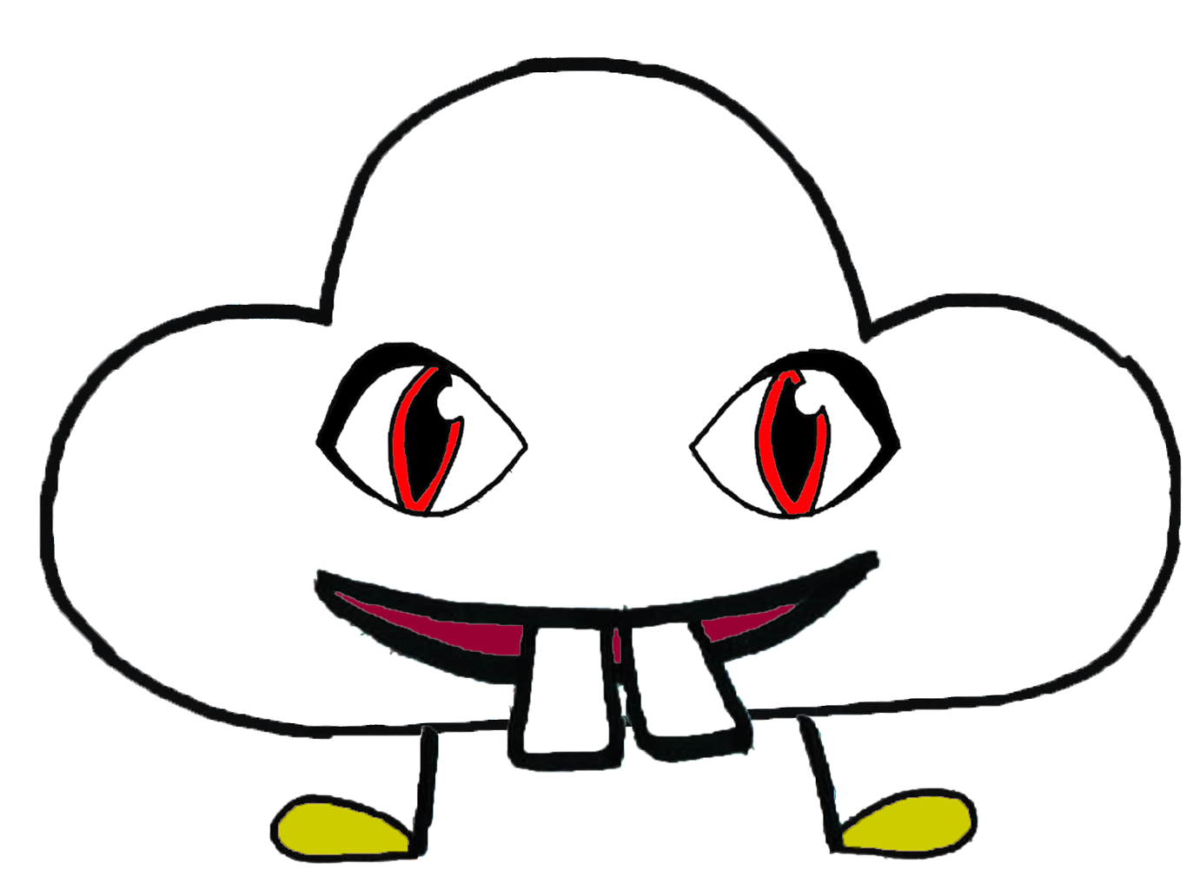






System
To win it, you have to collect Elements
A new competition each week
By being sustainable
By trading them
By buying them
The winner can benefit of the project
All the money is reinvest in local sustainable project
Ana Boskovic Svilen Stefanov Dimitar Dimitrov Luca Autunno
Simone Eberhart Marko Mihajlovic Maurice Cotting

Slide 5
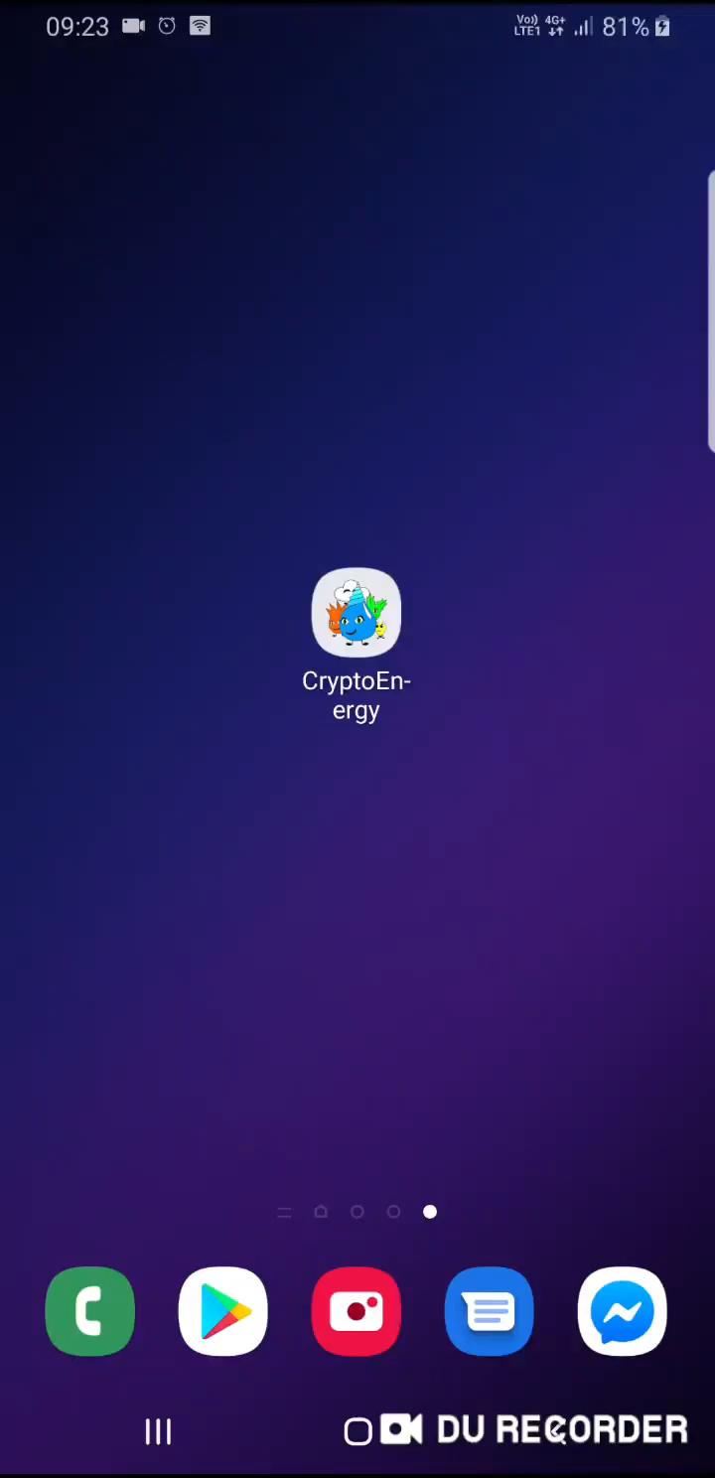

Demo video
Ana Boskovic Svilen Stefanov Dimitar Dimitrov Luca Autunno
Simone Eberhart Marko Mihajlovic Maurice Cotting

